Slide 1
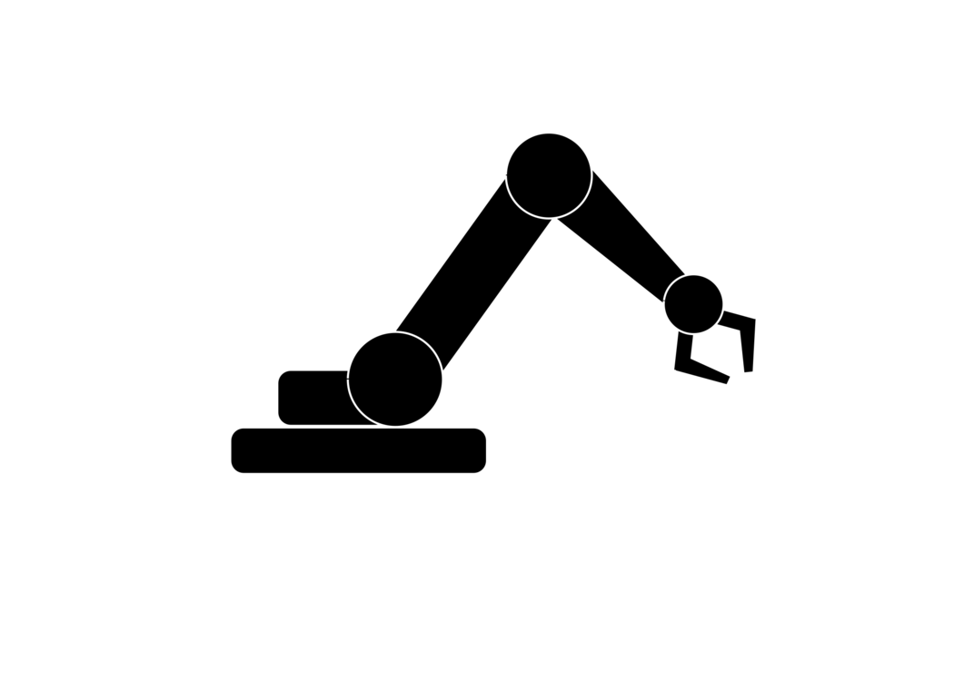







Robotic Arm
Ali Aqdas Ali Hamza Malik

Slide 2
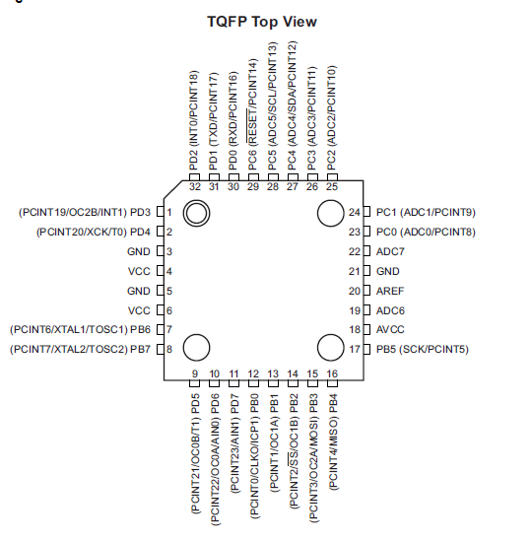
Project Description
Robotic Arm based on ATmega328p
Controlled using Potentiometers
Range of DOV From 1 to 8
Use of Two Microcontrollers

Slide 3

TX Microcontroller
ADC conversion with ATmega328p
Potentiometers values transmitted over USART
Various Arrangement for the Controlling Potentiometers

Slide 4
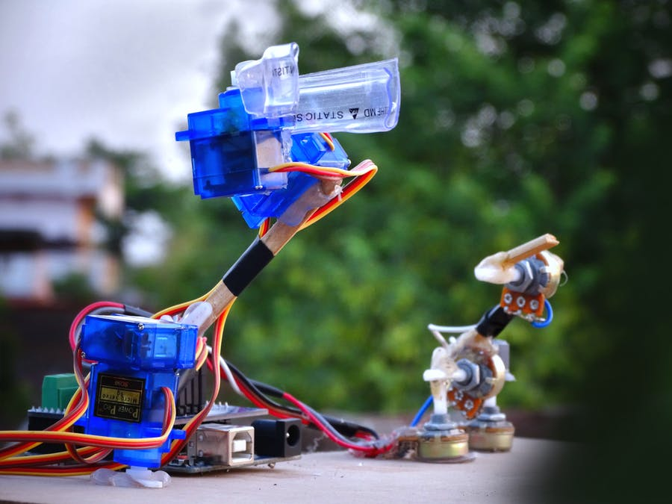
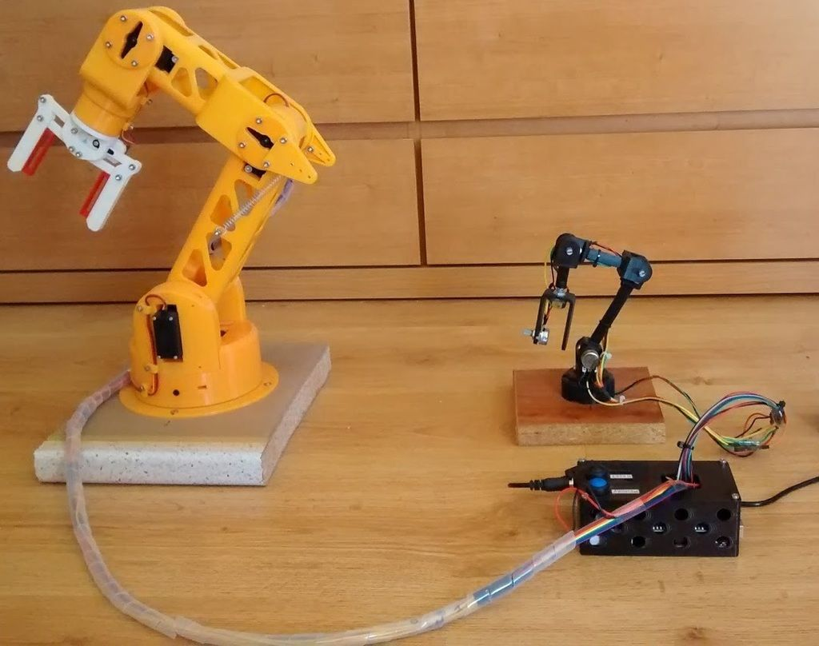
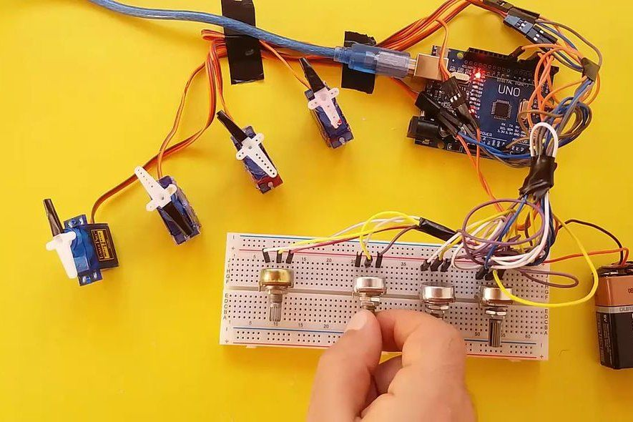

Slide 5
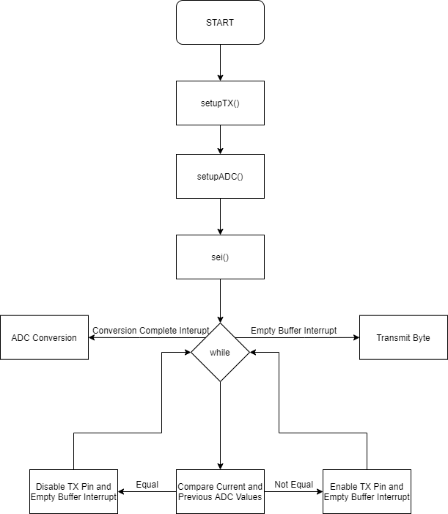
TX Microcontroller

Slide 6
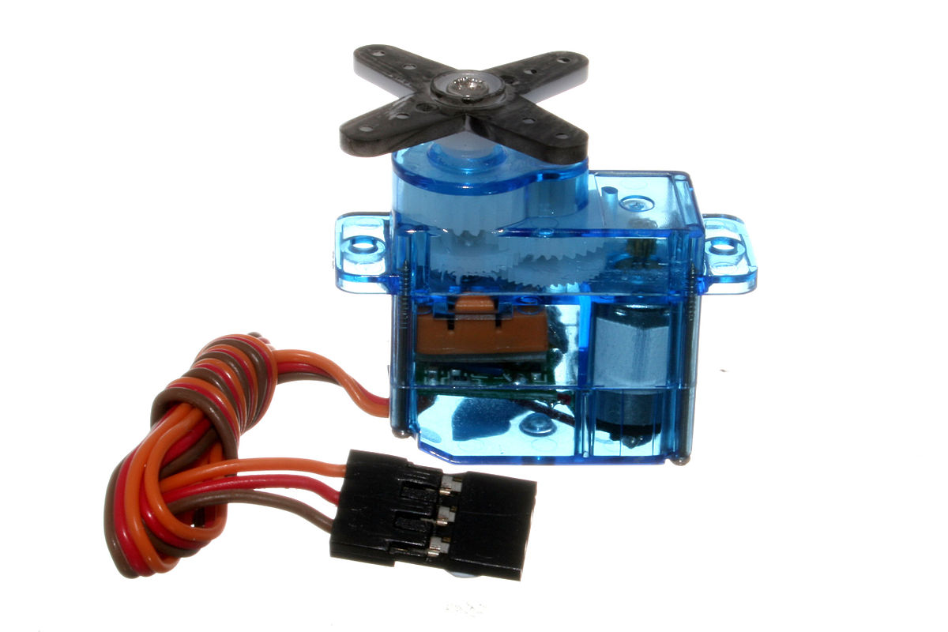
RX Microcontroller
Servo Motors wired to SERVO_PORT
Use of Soft PWM to generate Control Signal for servos
Angle Values Received over USART RX pin
Compatible with Bluetooth/WIFI/Radio Receiver/USB

Slide 7
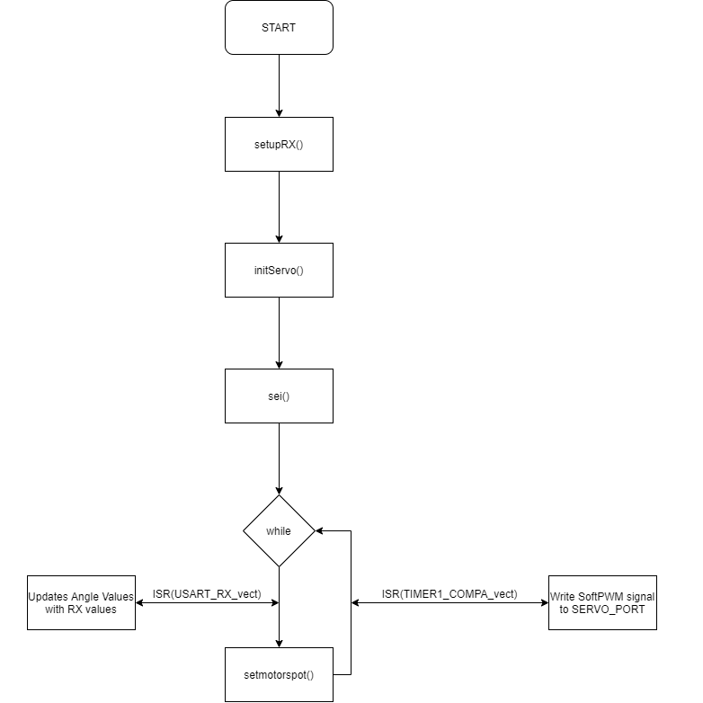
RX Microcontroller

Slide 8
Results
Algorithm for Soft PWM
Successfully Designed a Robotic Arm in Simulation

Slide 9
Future Prospects
Control Commands over USART (Instead of Controller)
From Smartphone through Bluetooth
Over Internet Through WIFI Module
Over USB From Computer
High-Level Movements through Inverse Kinematics and AI Control Over USART

